Slide 1
COAL PROJECT : PLAGUE CHECKER
[GROUP 14]
Group Leader : Jahanzaib[19k-1463]
Group Member: Ali Murtaza [19k-1404]
Group Member: Muhammad Sameer [19-1526]

Slide 2
INTRODUCTION :
Our Project is Known as Plague Checker. Which is develop
Under a formula or Algorithm. By the help of that
Algorithm we create a Program which is able to check the
Plagues of files by comparing them as well as at last our
Project program will also show you the percentage of plagiarism
Between compared files.
TOOLS:
We use Visual studio 2010 Ultimate.

Slide 3
System Diagram :
Print Group Details
Create Triplets of File1
Compare Triplets with File2 Details
Compare Triplets with File3 Details
Print Percentage of Plagiarism
Read File1,2,3

Slide 4
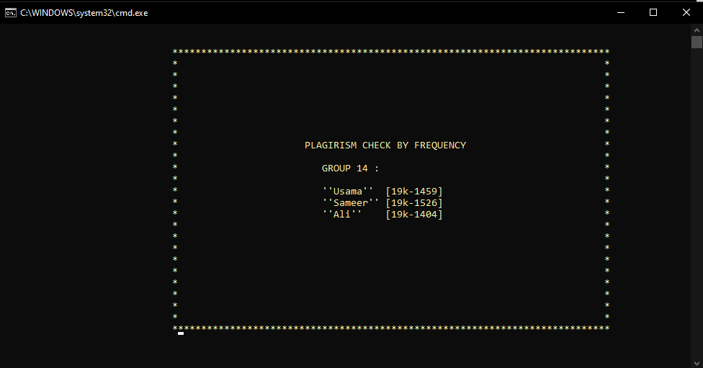
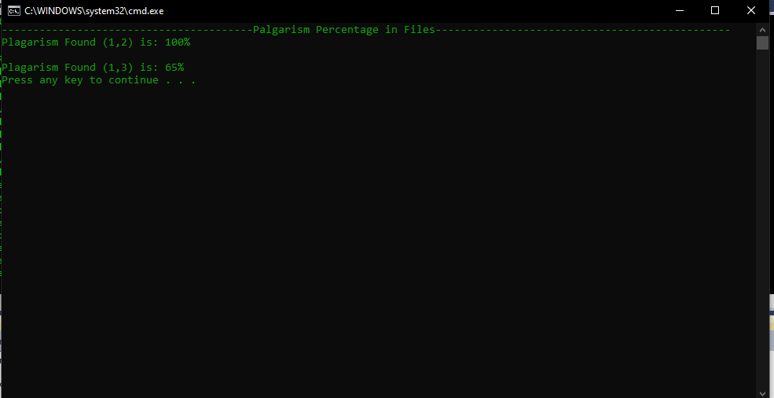
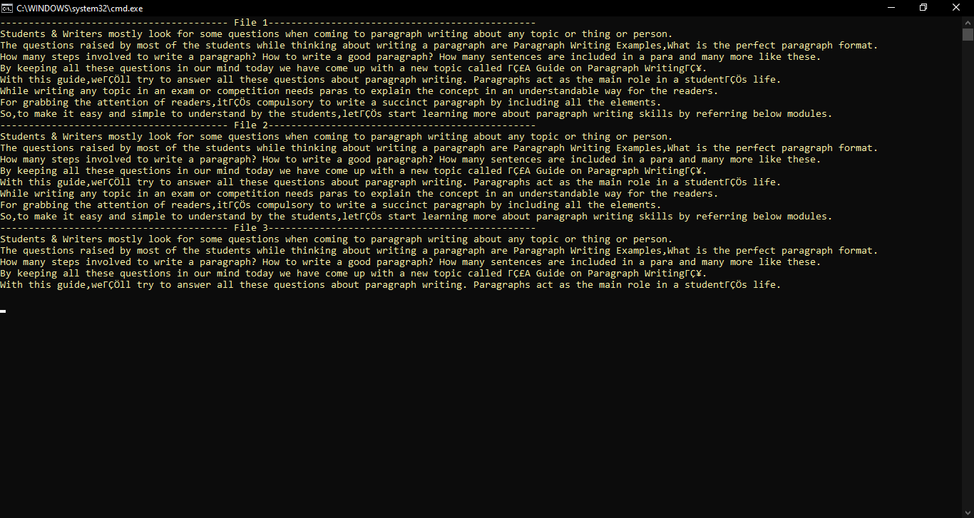

Slide 5
Flow of Program :
START
Printing Sqaure
With Names and Id`s
In Console
Read File1
Ecx = Length
Of File1
A

Slide 6
A
Yes
ecx!=0
Read From File1
No
Read File2
Ecx =Length
Of File2
No
Yes
Read From File2
B
ecx!=0

Slide 7
B
Read File3
Ecx =Length
Of File3
Yes
ecx!=0
Read From File3
No
Find no of
Triplets from
File1
Find no of
Triplets from
File1 , Ecx=no of triplets find
Yes
ecx!=0
No
Compare Triplets
Of File1 with File2
And File3 Data
Calculate
Percentage of
Plague of File1 with
File2 and File3
Display the
Percentage of Plague
END

Slide 8
TASK DISTRIBUTION:
Jahanzaib :
Firstly, I built up the Algorithm of making triplets of File.
So, the Algorithm is that:
no of Triplets can be made from a file = no of words in file – 2.
I applied this algorithm in Assembly code and create a function
To find out no of Triplets can be made from a file. Moreover, I also create
Another Function which produce Triplets from File1 and than call another
Function which compares that Triplet with another File (File2 and File3).

Slide 9
The Logic was that every Triplet Contains three words and up to so on
But if we make second Triplet after first one than the 2nd Word of First Triplet
Will be the First word of 2nd Triplet and up to so on to the end File.
I also use delay function and gotoxy subroutine to autotype the names and ID no`s of my Group Members and the name of my project.

Slide 10
Ali Murtaza:
My contribution in this project is only is I done the Starting Programs
Of Our Project means the Reading from File1,File2 and File3 as well
As storing their Details in a specific data member for every File.
Further more, I Printed the Names of Our Group in a square
As well as I do some code also for calculating Percentage
of Plagiarism of File1 from File2 and File3.

Slide 11
With the help of Gotoxy Subroutine I moved cursor in console because
To Print the Details of Group and Sqaure Shape with Starick.
In Gotoxy dh works for row and dl works for column.
I calculated Percentage of Plagiarism of File1 Triplets with File2
As well as the Percentage of Plagiarism of File1 Triplets with File3.

Slide 12
Muhammad Sameer:
I Created Two Functions Comparision_of_File_One_Triplets_With_File_Two in which it will compare single generated triplet with whole file if triplet found in the file it will add 1 to the sum of triplet found otherwise not.

Slide 13
Comparision_of_File_One_Triplets_With_File_Three which it will work to Compare the generated Triplets
Of File1 with complete File3 and calculate the no of
Sum of triplets found also.

Slide 14
REPORT:
BACKGROUND:
WE WANT TO DO SOME CHALLENGING TASK
SO WE COME WITH IDEA OF PLAGIRISM
CHECKING.AS THERE IS MANY CASES OF
CHEATING OBSERVED IN ENGLISH PAPER SO
WE WANT CREATE A PROGRAM WHICH
RESOLVED IT
Project Overview:
Two article are taken as a input from file
and sent to triplet finder where triplets
are found and sent to search function to compare triplet of file1 with file2and count frequency of comparison after whole file is compared the percentage is counted if it is greater than 50 then the article is cheated else not.

